Slide 1

Breast Cancer Detection

Slide 2
What is Breast Cancer?
Breast cancer is the second leading cause of cancer death in women.
As of 2019, on average, 1 in 8 U.S women (approx. 12%) would develop invasive breast cancer at some point during her life.
5-year survival rate for breast cancer is 100% with early detection and 15% with late detection (UK Cancer research)
Machine learning (ML) techniques play a key role in healthcare in recent years.
In the case of breast cancer, machine learning techniques can be used to distinguish between malignant and benign tumours for enabling early detection.
Most ML based applications focus on large data sets citing ML’s ability to handle big data.
However, from a user’s perspective most users have access to publicly available small data sets.
Thus, it is interesting to analyse if the traditional non complex basic ML algorithms can achieve high accuracy classifications using small datasets

Slide 3
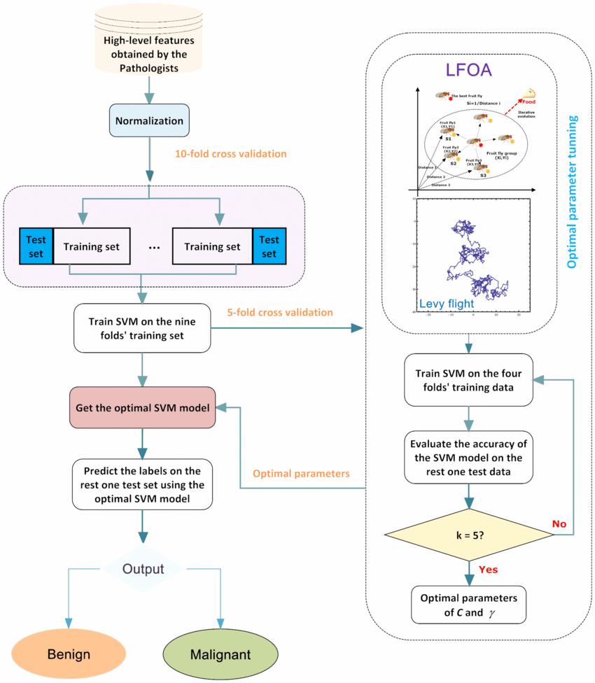
Flowchart

Slide 4
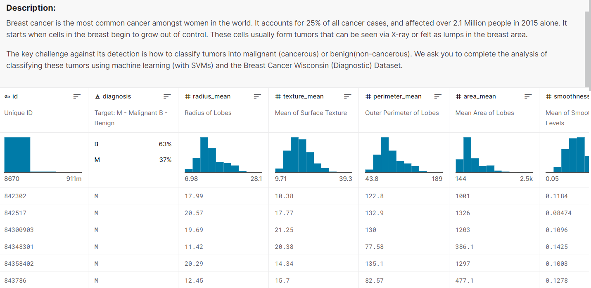
Step1: Collecting data from Kaggle

Slide 5
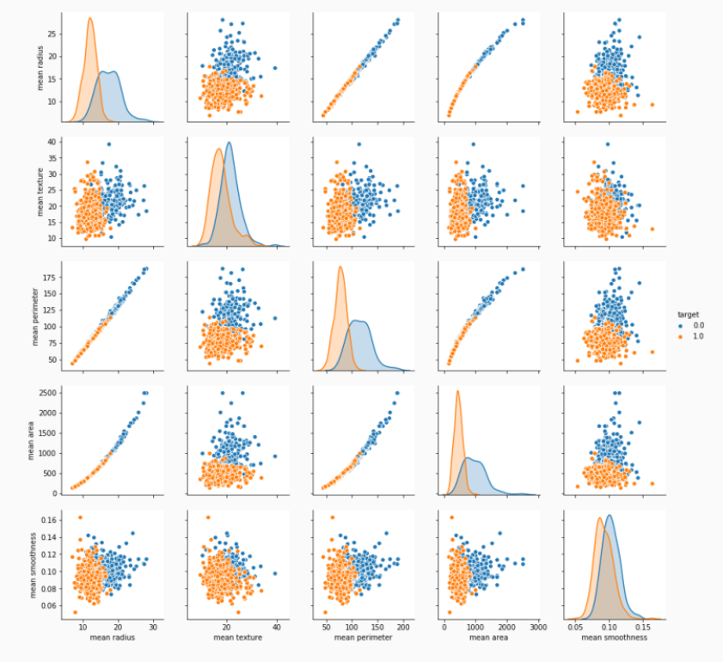
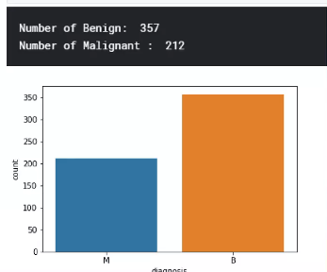
Step 2: Exploring and preparing dataset

Slide 6
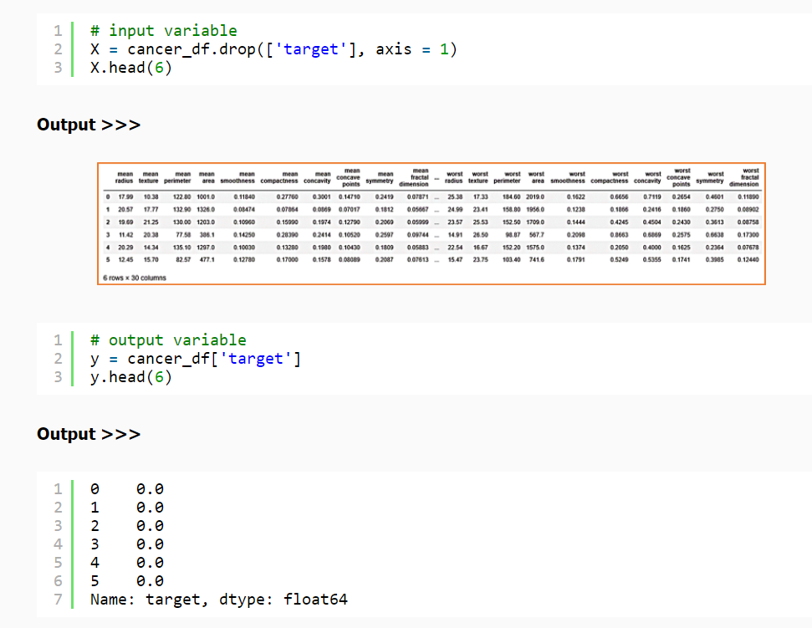
Step 3: Data Preprocessing
Splitting Dataframe in test and train

Slide 7
Step 4: Training the Model
To build the best model, we have to train and test the dataset with multiple Machine Learning algorithms then we can find the best ML model.
There are various algorithms used for training the model. Those are:-
Support Vector Classifier
Logistic and Polynomial Regression
K-Nearest Neighbor Classifier
Decision Tree Classifier
Naïve Bayes Classifier
Random Forest Classifier

Slide 8
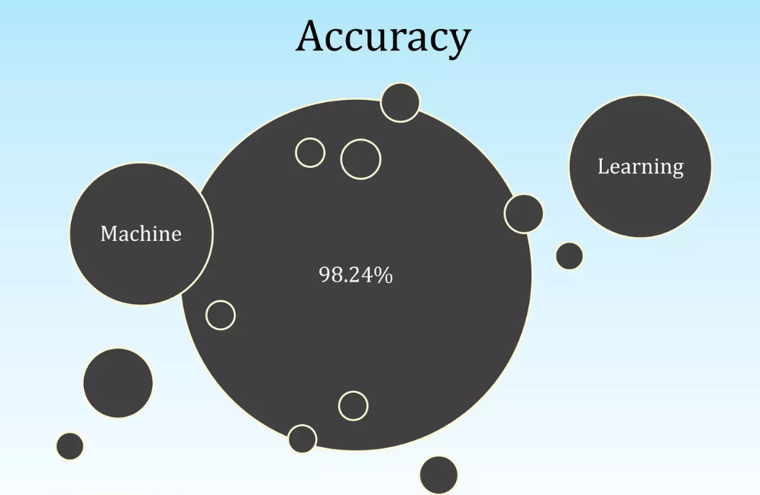
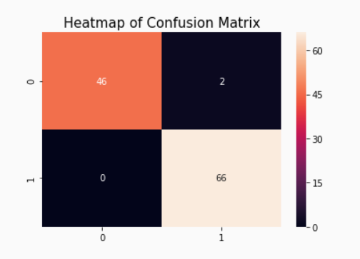
Step 5: Testing the Model
Confusion Matrix calculates the accuracy

Slide 9


